Slide 1
TINY MACHINE LEARNING
SUPERVISOR:ADLEN KSENTINI
BY
Nandhini MAGUDESWARAN
Venithraa GANESAN

Slide 2
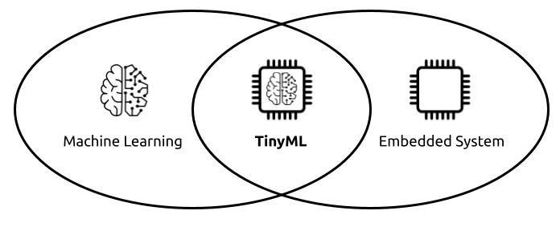
What is Tiny ML?
Tiny Machine Learning (Tiny ML) is a field of study at the intersection of machine learning (ML) and embedded systems
Tiny ML is a type of machine learning that shrinks deep learning networks to fit on tiny hardware combines hardware,software and algorithms
It is 45x18mm of Artificial Intelligence in your pocket

Slide 3
RASPBERRY PI
Compact device that enables people of all ages to explore computing, and to learn how to program in languages like Scratch and Python.
The Raspberry Pi has the ability to interact with the outside world, and has been used in a wide array of digital maker projects.
Pi is being used by world to learn to program and understand how computers work.
Allows you to control electronic components for physical computing and explore the Internet of Things (IoT).

Slide 4
TINY ML IN IOT
To provide
Low Latency
Effective Bandwidth utilization
Data safety
Enhance privacy
Reduce cost

Slide 5
TINY ML APPLICATION AND USE CASES
Manufacturing: TinyML-powered predictive maintenance can reduce the downtime and costs associated with equipment failure.
Retail: TinyML can be used to monitor inventories and send alerts. This can prevent out-of-stock situations.
Agriculture: TinyML devices can be used to get real-time data by monitoring crops or livestock.
Healthcare: Real-time health monitoring enabled by TinyML devices can deliver better and more personalized patient care.

Slide 6
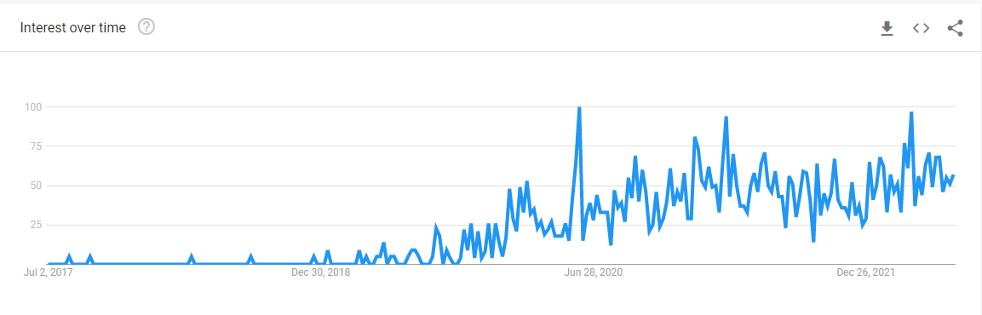
WHY TINYML IS IMPORTANT NOW?

Slide 7
IMPLEMENTATION
There are a couple of machine learning frameworks that support TinyML applications. These are:
TensorFlow Lite
PyTorch
Edge Impulse

Slide 8
PROJECT OVERVIEW
CASE STUDY OF COMPARING MACHINE LEARNING IN A COMPUTER AND TINY ML IN RASPBERRY PI MODEL 3
WE TRIED TO OBSERVE THE COMPUTATION TIME AND THE CPU CONSUMPTION OF VARIOUS MACHINE LEARNING MODELS
TENSOR FLOW LITE VS TENSOR FLOW FOR OBJECT DETECTION
TOOLS : SKLEARN, TENSORFLOW LITE, TENSOR FLOW
DATASET : KAGGLE (MOVIE DATA), SKLEARN (IRIS, DIABATIC) , MOBILENET (OBJECT DETECTION)

Slide 9
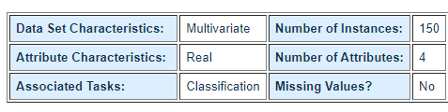
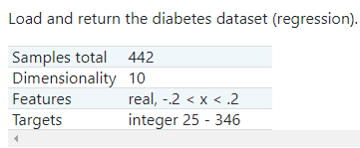
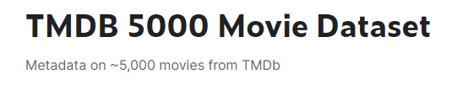
METHODOLOGY
FIRSTLY, WE INSTALLED THE RASPBERRY OS IN RASPBERRY PI AND INSTALLED FEW LIBRARIES IN ORDER TO RUN THE MODELS
WE COMPARED 2 SMALL MODELS BY RUNNING IT IN THE COMPUTER AND AS WELL AS THE RASPBERRY PI
BIGGER DATA SET - TOTAL SAMPLES (5000)
DATASET IN CSV FILE
USING DIFFERENT REGRESSION MODELS
- RIDGE REGRESSION
- KNN
- BAYESIAN
- DECISION TREE
- SVM

Slide 10
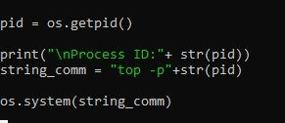
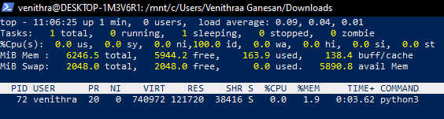
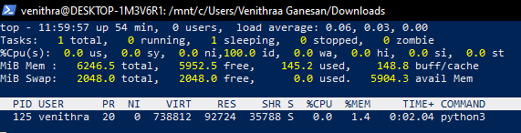
RESULTS (IN CPU)
REGRESSION
CLASSIFICATION

Slide 11
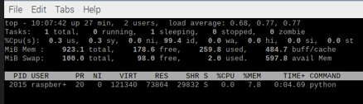
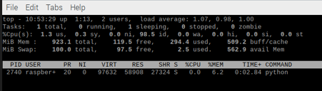
RESULTS ( IN RASPBERRY PI )
REGRESSION
CLASSIFICATION

Slide 12
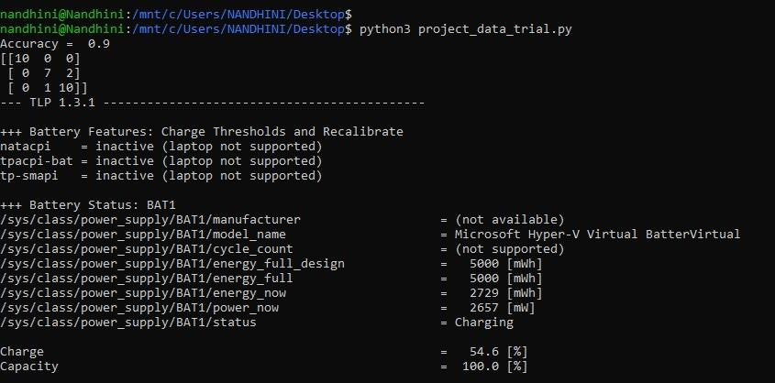
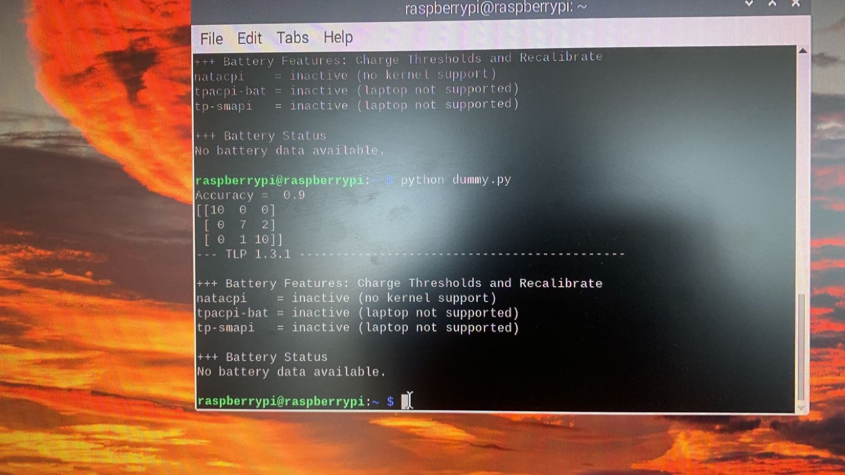
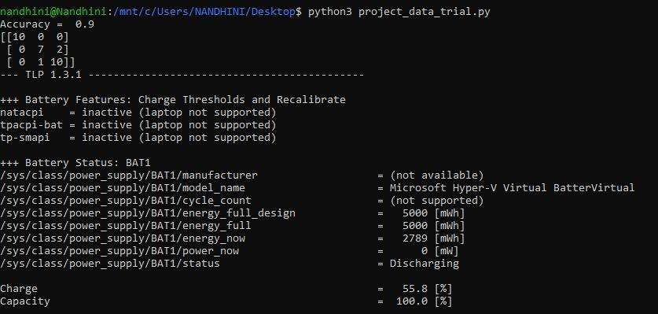
BATTERY POWER CONSUMPTION(CPU VS PI)

Slide 13
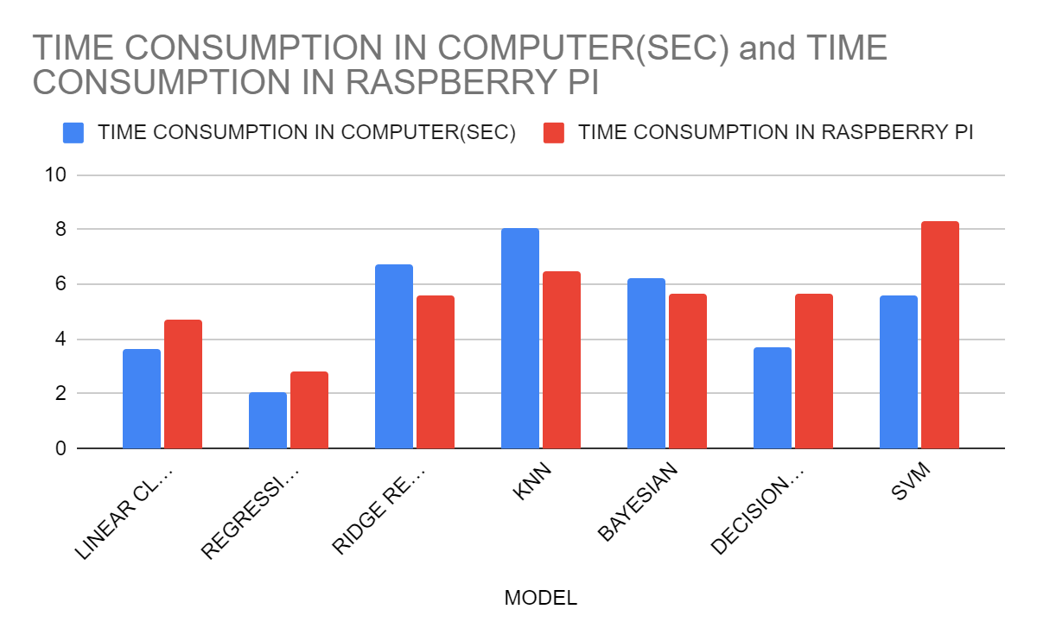
RESULTS

Slide 14
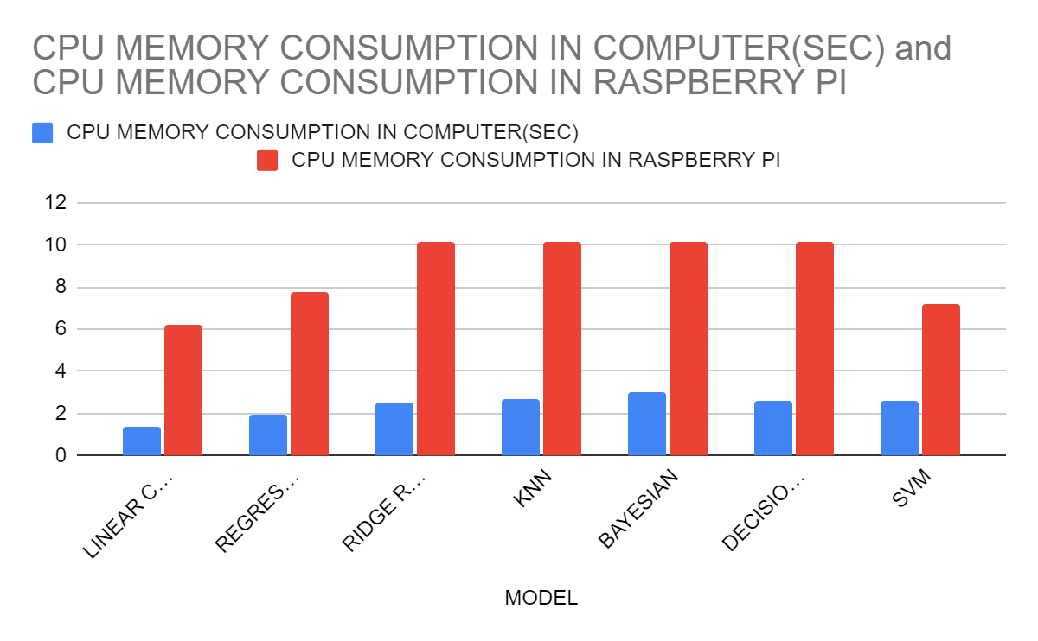
RESULT

Slide 15
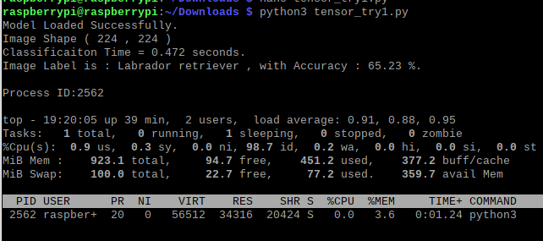
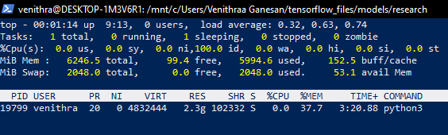
USING TENSOR FLOW AND TENSOR FLOW LITE
OBJECT DETECTION USING IMAGES
TENSOR FLOW - IN THE COMPUTER TENSOR FLOW LITE - IN RASPBERRY PI

Slide 16
CONCLUSION
TOOLS : SKLEARN, TENSORFLOW LITE, TENSOR FLOW
DATASET : KAGGLE (MOVIE DATA), SKLEARN (IRIS, DIABATIC) , MOBILENET
FOR MACHINE LEARNING MODELS
TIME CONSUMPTION DOESN’T NOT DEPEND ON THE DATA SET. IT MAY VARY ACCORDING TO THE MODEL
THE CPU MEMORY CONSUMPTION OF THE PI WAY ALWAYS MORE THAN THE COMPUTER
FOR OBJECT DETECTION
THE PI PERFORMED BETTER THAN THE COMPUTER

Slide 17
REFERENCE
OBJECT DETECTION USING TENSOR FLOW - https://www.mygreatlearning.com/blog/object-detection-using-tensorflow/
OBJECT DETECTION USING TENSORFLOW LITE - https://blog.paperspace.com/tensorflow-lite-raspberry-pi/
REGRESSION MODELS (MOVIE DATA) - https://www.kaggle.com/code/ankitjha/comparing-regression-models/notebook
CLASSIFICATION MODEL - https://scikit-learn.org/stable/modules/generated/sklearn.datasets.load_diabetes.html

Slide 18
THANK YOU

